Slide 1

Foundation Course in CGE Modeling Using IFPRI’s Static CGE and Microsimulation Models

Slide 2
Overview _{(Parts 1-7)}
Why Do Economywide Analysis?
Social Accounting Matrices (SAMs)
SAM Multiplier Analysis
Simple CGE Model
IFPRI Standard CGE Model
Microsoft-Excel® Interface
Extending the Standard Model

Slide 3
Part 1 Why Do Economywide Analysis?

Slide 4
Agrifood Systems
Agriculture
Input suppliers
Traders
Off-farm components of the agrifood system are more important than on-farm components at higher-income levels.
Processors
Traders
Share of national GDP (%)
Share of agrifood GDP (%)
Share of off-farm agrifood GDP (%)
Food services

Slide 5
Private Sector
Low-Income Countries
Public-Sector-Driven Transformation
Actions government must undertake in most circumstances (e.g., infrastructure, education, R&D, extension services, etc.)
Public-Private Sector Coordination
Actions private sector will undertake if governments create an enabling environment (i.e., conducive policies & investments)
Agricultural Transformation
Private-Sector-Driven Transformation
Actions private sector will undertake on its own (e.g., supplying profitable input & output markets where demand is strong)
High-Income Countries

Slide 6
Economywide Models
Activities (producers)
Computable General Equilibrium
Economic linkages
Between sectors, households, government & rest of world
Resource competition
Factor markets (land, labor, capital)
Product markets (supply, demand)
Macro consistency
Government (revenues, spending)
Savings-investment
Current account (foreign exchange)
Farming
Trading
Processing
Non-AFS
Investments & subsidies
Regional
Trade
Factor markets
Product markets
Rest of world
Aid
Regional
National
Taxes
Government
Households (consumers)
Regional migration & remittances
Rural
poor
Rural
nonpoor
Social transfers
Urban
poor
Urban
nonpoor
Regional

Slide 7
Types of Economywide Studies
Foresight Analysis
Tracking progress
Setting targets & goals
Impact Evaluation
Capturing spillovers
Estimating benefits & costs
Strategic Planning
Evaluating Programs
CGE Model
Prioritizing Portfolios
Policy & Investment Choices
Identifying priorities, Optimizing budgets

Slide 8
Data Reconciliation
Firm surveys
Input costs
Profits
Household surveys
Product consumption & diets
Labor, land & enterprise earnings
Taxes & transfers
National accounts
GDP by sector
Product supply & use
Transaction costs
Labor force surveys
Jobs & earnings by sector
Determinants of employment
Balance of payments
Product trade flows
Remittances
Foreign investments
Development assistance
Social Accounting Matrix
Micro- simulation
CGE
Model
Government
Consumption spending
Social transfers
Tax collections
Debt & interest
Simulation design
Program evaluation studies
Estimates of direct policy impacts
Behavioral change
Public finance studies
Tax & expenditure policy
Borrowing & debt repayment
Firm & industry studies
Changes in value chains & technologies

Slide 9
Part 2 Social Accounting Matrices (SAMs)

Slide 10

What Is a SAM?
SAMs are national accounting frameworks or databases
SAMs capture the circular flow of receipts and payments between economic agents and markets during a given year
SAMs include all sectors, factors, households, government and the rest of the world (i.e., economywide)
Every payment becomes someone else’s income (i.e., consistent double-entry accounting)

Slide 11
Circular Flow
Factor costs
Wages & rents
Factor Markets
Domestic private savings
Direct taxes
Public savings
Firms
Households
Government
Savings & Investment
Intermediate demand
Social transfers
Indirect taxes
Product Markets
Sales
Private consumption
Public consumption
Investment demand
Imports
Exports
Foreign Markets
Foreign savings or capital inflows

Slide 12
Accounting Identities
F
Factor costs
Wages & rents
S
Factor Markets
Domestic private savings
S
Direct taxes
Public savings
Firms
Households
Government
Savings & Investment
Intermediate demand
Social transfers
T
Indirect taxes
Product Markets
Sales
Private consumption
Public consumption
Investment demand
M
C
G
I
X
Imports
S
Exports
Foreign Markets
Foreign savings or capital inflows
GDP at market prices = C + I + G + X – M
Total Investment I = Total Savings S
GDP at market prices = GDP at factor cost F + Indirect Taxes T

Slide 13
SAM Structure
 | ACT | COM | FAC | HHD | GOV | INV | ROW | TOT
ACT |  | Marketed output |  |  |  |  |  | Activity incomes
COM | Intermediate demand |  |  | Private consumption | Public consumption | Investment demand | Exports | Total demand
FAC | Value added |  |  |  |  |  |  | Factors incomes
HHD |  |  | Income distribution |  | Social transfers |  | Remittances | Household incomes
GOV | Producer taxes | Tariffs, VAT & excise taxes |  | Direct taxes |  |  | Foreign aid | Government revenues
SAV |  |  |  | Private savings | Public savings |  | Foreign savings | Total savings
ROW |  | Imports | Repatriated profits |  | Debt repayments |  |  | Foreign payments
TOT | Gross output | Total supply | Factor payments | Household expenditures | Government expenditures | Total investment | Foreign receipts
Incomes across rows
Expenditures down columns

Slide 14
Macro SAM | Data Sources
Three main data sources:
National Accounts (activity and commodity accounts)
Government Financial Statistics (spending and tax accounts)
Balance of Payments (external account)
Standardized concordance between SAM and classification systems
GFS2014 & BOP6 → SNA 2008 → Macro SAM accounts
Inconsistent values across sources requires reconciliation:
Consistency with national accounts usually afforded highest priority, followed by BOPs and then GFS

Slide 15
Macro SAM | Entries
Incomes across rows
 | Act | Com | Fact | Ent | Hhd | Gov | Tax | S-I | Stk | Wld | Tot
Activities |  | NA |  |  |  |  |  |  |  |  | NA
Commodities | NA |  |  |  | NA | NA |  | NA | NA | NA | NA
Factors | NA |  |  |  |  |  |  |  |  | BOP | X
Enterprises |  |  | X |  |  | GFS |  |  |  | BOP | X
Households |  |  | X | X |  | GFS |  |  |  | BOP | X
Government |  |  | GFS | GFS | GFS |  | GFS |  |  | BOP | GFS
Taxes | NA | NA | GFS | GFS | GFS |  |  |  |  |  | GFS
Savings |  |  |  | ? | X | GFS |  |  |  | BOP | X
Stock change |  |  |  |  |  |  |  | NA |  |  | X
Rest of world |  | NA | BOP | BOP | BOP | BOP |  |  |  |  | BOP
Total | NA | NA | X | X | X | GFS | GFS | NA | NA | BOP
Expenditures down columns
NA National Accounts
GFS Government Financial Statistics
BOP Balance of Payments
X Convention or residual

Slide 16
Macro SAM | Details
Incomes across rows
 | Act | Com | Fact | Ent | Hhd | Gov | Tax | S-I | Stk | Wld | Tot
Activities
Commodities
Factors
Enterprises
Households
Government
Taxes
Savings
Stock change
Rest of world
Total
Expenditures down columns
Factors
Labor | Land | Capital
Taxes
Activities (producer) | Export duties | Import duties | Sales or VAT | Factor | Direct

Slide 17
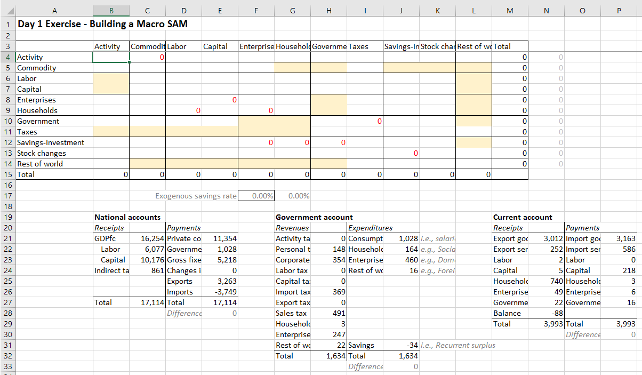
Exercise 1 | Building a Macro SAM
Complete the Macro SAM using the data provided below
Yellow cells need data from the tables
Red numbers contain formulas that will update automatically
Exercises folder
Exercise 1 - Macro SAM.xlsx

Slide 18
Supply-Use Table | Details
Incomes across rows
 | Act | Com | Fact | Ent | Hhd | Gov | Tax | S-I | Stk | Wld | Tot
Activities
Commodities
Factors
Enterprises
Households
Government
Taxes
Savings
Stock change
Rest of world
Total
86 activities + 86 commodities
Expenditures down columns
IFPRI Standard NEXUS SAM structure
Individual countries may vary

Slide 19
Supply-Use Table | Accounts
Agricultural activities/commodities
Maize | Sorghum + millet | Rice | Wheat + barley | Other cereals | Pulses | Groundnuts | Other oilseeds | Cassava | Irish potatoes |
Sweet potatoes | Other roots | Leafy vegetables | Other vegetables | Sugarcane | Tobacco | Cotton + fibers | Nuts | Bananas + plantains |
Other fruits | Tea | Coffee | Cocoa | Cut flowers | Rubber | Other crops | Cattle | Raw milk | Poultry | Eggs | Sheep + goats |
Other livestock | Forestry | Aquaculture | Capture fisheries
35
Industrial activities/commodities
Coal | Crude oil | Natural gas | Other mining | Meat | Fish + seafood | Dairy | Fruits + vegetables | Fats + oils | Maize milling |
Sorghum + millet milling | Rice milling | Wheat + barley milling | Other grain milling | Sugar refining | Coffee processing | Tea processing |
Other foods | Animal feed | Beverages | Tobacco | Cotton yarn | Textiles | Clothing | Leather + footwear | Wood | Paper | Petroleum |
Chemicals | Non-metal minerals | Metals + metal products | Machinery | Equipment | Vehicles | Other manufacturing | Electricity + gas |
Water supply + sewage | Construction
39
Service activities/commodities
12
Wholesale + retail trade | Transportation + storage | Accommodation | Food services | Information + communication | Finance + insurance |
Real estate activities | Business services | Public administration | Education | Health + social work | Other services
IFPRI Standard NEXUS SAM structure
Individual countries may vary

Slide 20
Supply-Use Table | Data Sources
Main data sources:
National accounts (GDP by sector, trade margins)
Agricultural and industrial production data and surveys
Input-output table
Trade and tax data (esp. VAT and customs duties)
Household expenditure survey (consumption demand vector)
Standardized concordance between SAM and classification systems
ISIC3.1, ISIC4, HS2012, COICOP → Disaggregated SAM accounts
Inconsistent values across sources requires reconciliation:
Balanced using cross-entropy techniques in GAMS®

Slide 21
Social Transfers | Details
Incomes across rows
 | Act | Com | Fact | Ent | Hhd | Gov | Tax | S-I | Stk | Wld | Tot
Activities
Commodities
Factors
Enterprises
Households
Government
Taxes
Savings
Stock change
Rest of world
Total
13 factors
Expenditures down columns
15 households
IFPRI Standard NEXUS SAM structure
Individual countries may vary

Slide 22
Social Transfers | Accounts
Factors of production
13
Crop land | Crop, livestock, mining and nonagricultural capital | Rural and urban labor by education category
Household groups
15
Rural farm and nonfarm households and urban households by national per capita expenditure quintiles
IFPRI Standard NEXUS SAM structure
Individual countries may vary

Slide 23
Social Transfers | Data Sources
Main data sources:
Household & labor force surveys
Map sector of employment to Nexus activities
ISIC3.1, ISIC4 → Disaggregated SAM accounts
Map consumption items to Nexus commodities
COICOP, etc. → Disaggregated SAM accounts
Maintain macro SAM and non-factor/household accounts
Only imbalances are for detailed household accounts
Balanced using cross-entropy in GAMS

Slide 24
Balancing SAMs | RAS Method
One approach is to use the RAS method
Rows and columns are uniformly scaled in iteration until totals converge
Advantages: Simple to implement (even in Excel)
Shortcoming: Can do significant “damage” to the original data (will adjust cells, even if they are not causing the imbalance)
 | Act | Com | Fact | Ent | Hhd | Gov | Tax | S-I | Stk | Wld | Tot
Activities |  |  |  |  |  |  |  |  |  |  | X
Commodities |  |  |  |  |  |  |  |  |  |  | X
Factors |  |  |  |  |  |  |  |  |  |  | X
Enterprises |  |  |  |  |  |  |  |  |  |  | X
Households |  |  |  |  |  |  |  |  |  |  | X
Government |  |  |  |  |  |  |  |  |  |  | X
Taxes |  |  |  |  |  |  |  |  |  |  | X
Savings |  |  |  |  |  |  |  |  |  |  | X
Stock change |  |  |  |  |  |  |  |  |  |  | X
Rest of world |  |  |  |  |  |  |  |  |  |  | X
Total | X | X | X | X | X | X | X | X | X | X

Slide 25
Balancing SAMs | Cross-Entropy Method
Better approach is to use the cross-entropy method
Each cell is adjusted individually (rather than entire rows & columns)
Minimize deviation from original data (using error distributions)
Advantages: Focus more on cells that are causing imbalances
Shortcoming: More complex (need GAMS rather than just Excel)
 | Act | Com | Fact | Ent | Hhd | Gov | Tax | S-I | Stk | Wld | Tot
Activities |  |  |  |  |  |  |  |  |  |  | X
Commodities |  |  |  |  |  |  |  |  |  |  | X
Factors |  |  |  |  |  |  |  |  |  |  | X
Enterprises |  |  |  |  |  |  |  |  |  |  | X
Households |  |  |  |  |  |  |  |  |  |  | X
Government |  |  |  |  |  |  |  |  |  |  | X
Taxes |  |  |  |  |  |  |  |  |  |  | X
Savings |  |  |  |  |  |  |  |  |  |  | X
Stock change |  |  |  |  |  |  |  |  |  |  | X
Rest of world |  |  |  |  |  |  |  |  |  |  | X
Total | X | X | X | X | X | X | X | X | X | X

Slide 26
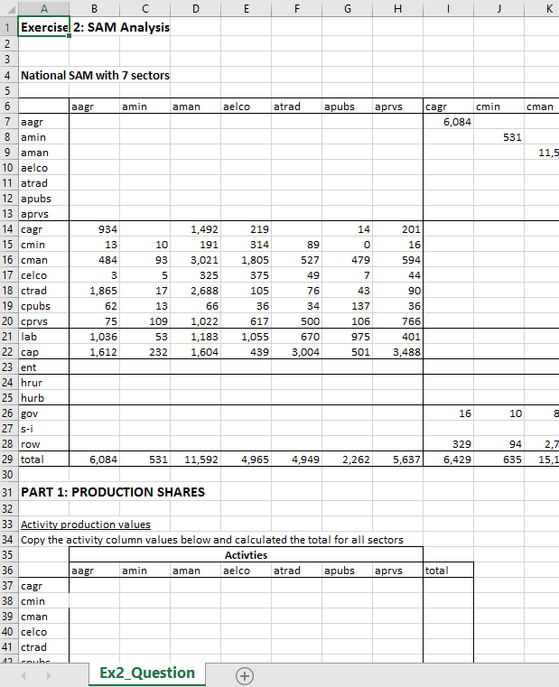
Exercise 2 | SAM Analysis
Aggregated SAM
7 activities, 7 commodities
2 households (rural & urban)
Answer questions about the structure of the economy
Link to data in the SAM
Check your answers as you go (correct values shown in blue)
Exercises folder
Exercise 2 – SAM Analysis.xlsx

Slide 27
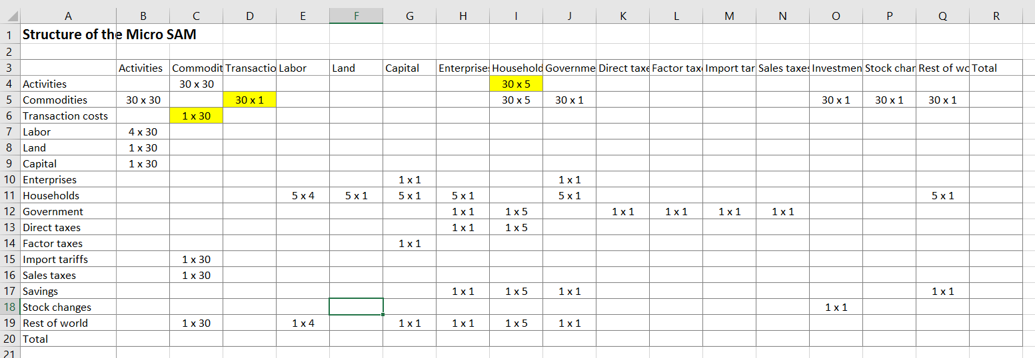
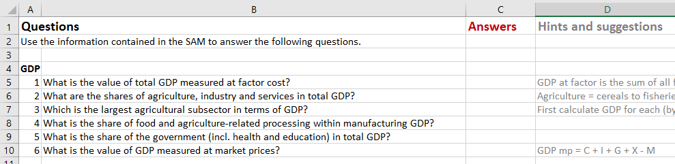
Exercise 2x | Detailed SAM Analysis
Answer the questions using data from the SAM
Use the workings sheet for calculations
Exercises folder
Exercise 2x – Detailed SAM Analysis.xlsx

Slide 28
Part 3 SAM Multiplier Analysis

Slide 29
Direct and Indirect Linkages
Total impact of demand shock = Direct effects + Indirect effects
Indirect effects = Production linkages + Consumption linkages
Consumption linkages: incomes → demand for other sectors’ products
Production linkages = Backward linkages + forward linkages
Backward linkages: producers purchase of inputs from other sectors
Forward linkages: supply of upstream producers with intermediate inputs
Direct effects
Consumption linkages
Exogenous shock
Indirect effects
Backward linkages
Production linkages
Forward linkages

Slide 30
Circular Income Flow in Multiplier Process
Increase in agricultural exports
Direct effect
Indirect effects
A: Output multipliers
B: GDP (value-added) multiplier
C: Income multiplier
A
Increase in agricultural production
Production linkages
A
Increase in nonagricultural production
B
Increase in factor incomes and employment
Tax leakage
Government
Consumption linkages
C
Increase in household incomes and consumption
Import leakage
Rest of world

Slide 31
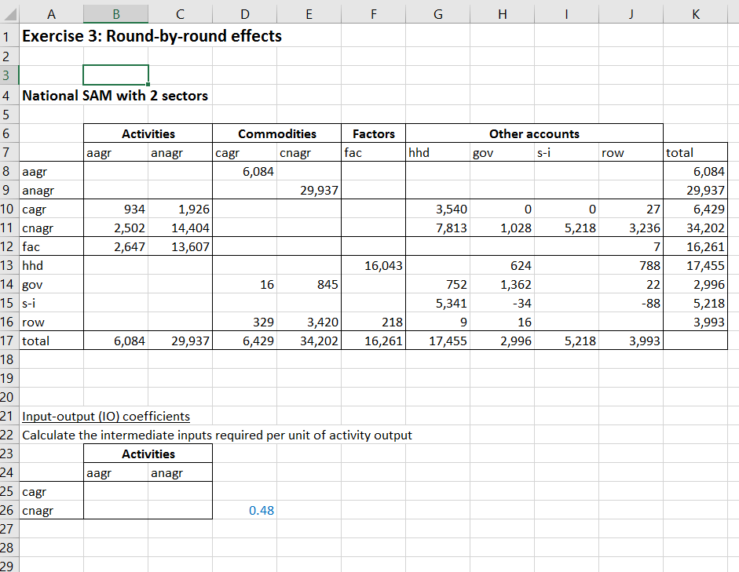
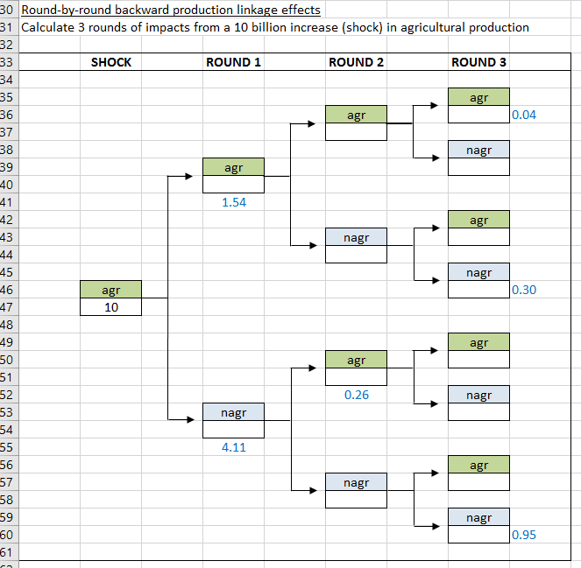
Exercise 3 | Round-By-Round Effects
Manually calculate indirect effects
Backward production linkages only
3 rounds of effects
Check calculations as you go (blue)
Exercises folder
Exercise 3 – Round-By-Round Effects.xlsx

Slide 32
Key Assumptions for Multipliers
Three assumptions behind multipliers…
Fixed prices: Any changes in demand lead to changes in physical output rather than prices.
Unlimited resources: Factor supplies are unconstrained, so that any increase in demand is matched by increased supply.
Fixed input coefficients: Production technologies and households’ consumption patterns are unaffected by exogenous changes in demand (i.e., linkage effects are linear and there is no behavioral change).

Slide 33
SAM Entries Using Letters or Symbols
We can replace the values appearing in the SAM with letters so that we can use them in deriving the multiplier formula…
 | Activities |  | Commodities |  | Factors | House-holds | Exogenous demand | Total
 | A1 | A2 | C1 | C2 | F | H | E
A1 |  |  | X₁ |  |  |  |  | X₁
A2 |  |  |  | X₂ |  |  |  | X₂
C1 | Z₁₁ | Z₁₂ |  |  |  | C₁ | E₁ | Z₁
C2 | Z₂₁ | Z₂₂ |  |  |  | C₂ | E₂ | Z₂
F | V₁ | V₂ |  |  |  |  |  | V
H |  |  |  |  | V₁ + V₂ |  |  | Y
E |  |  | L₁ | L₂ |  | S |  | E
Total | X₁ | X₂ | Z₁ | Z₂ | V | Y | E
X = gross output of each activity (i.e., X₁ and X₂)
Z = total demand for each commodity (i.e., Z₁ and Z₂)
V = total factor income (equal to household income)
Y = total household income (equal to total factor income)
E = exogenous components of demand (i.e., government, investment & exports)

Slide 34
Coefficient Matrix (M)
We then divide each column through by its column total to derive a coefficients matrix (called “M-matrix”)…
 | Activities |  | Commodities |  | Factors | House-holds | Exogenous demand | Total
 | A1 | A2 | C1 | C2 | F | H | E
A1 |  |  | b₁= X₁/Z₁ |  |  |  |  | X₁
A2 |  |  |  | b₂= X₂/Z₂ |  |  |  | X₂
C1 | a₁₁=Z₁₁/X₁ | a₁₂=Z₁₂/X₂ |  |  |  | c₁ = C₁/Y | E₁ | Z₁
C2 | a₂₁=Z₂₁/X₁ | a₂₂=Z₂₂/X₂ |  |  |  | c₂ = C₂/Y | E₂ | Z₂
F | v₁=V₁/X₁ | v₂=V₂/X₂ |  |  |  |  |  | V
H |  |  |  |  | 1 |  |  | Y
E |  |  | l₁ = L₁/Z₁ | l₂ = L₂/Z₂ |  | s = S/Y |  | E
Total | 1 | 1 | 1 | 1 | 1 | 1 | E
a = technical coefficients (i.e., input or intermediate shares in production)
b = share of domestic output in total demand
v = the share of value-added or factor income in gross output
l = share of the value of total demand from imports or commodity taxes
c = household consumption expenditure shares
s = household savings rate (i.e., savings as a share of total household income)

Slide 35





Multiplier Formula (1)
Total demand Z in each sector is the sum of intermediate input demand, household consumption demand, and other exogenous sources of demand E…
$$Z_{1}\text{=}{\text{a}}_{\text{11}} {\text{X}}_{1}\text{+}{\text{a}}_{\text{12}} {\text{X}}_{2}\text{+}{\text{c}}_{1} \text{Y}\text{+}{\text{E}}_{1}$$
$$Z_{2}\text{=}{\text{a}}_{\text{21}} {\text{X}}_{1}\text{+}{\text{a}}_{\text{22}} {\text{X}}_{2}\text{+}{\text{c}}_{2} \text{Y}\text{+}{\text{E}}_{2}$$
From the SAM we know that gross output X is only part of total demand Z…
$$X_{1}\text{=}{\text{b}}_{1} {\text{Z}}_{1}$$
$$X_{2}\text{=}{\text{b}}_{2} {\text{Z}}_{2}$$
We also know household income Y depends on factor earnings in each sector…
$$\text{Y}\text{=}{\text{v}}_{1}X_{1}+v_{2}X_{2}=v_{1}b_{1}Z_{1}+v_{2}b_{2}Z_{2}$$
We can now replace X and Y in the demand equations…
$$Z_{1}=a_{11}b_{1} Z_{1}\text{+}{\text{a}}_{\text{12}}b_{2} {\text{Z}}_{2}\text{+}{\text{c}}_{1}\left(v_{1}b_{1}Z_{1}+v_{2}b_{2}Z_{2}\right)\text{+}{\text{E}}_{1}$$
$$Z_{2}=a_{21}b_{1} Z_{1}\text{+}{\text{a}}_{\text{22}}b_{2} {\text{Z}}_{2}\text{+}{\text{c}}_{2}\left(v_{1}b_{1}Z_{1}+v_{2}b_{2}Z_{2}\right)\text{+}{\text{E}}_{2}$$

Slide 36
Multiplier Formula (2)
From the previous slide…
$$Z_{1}=a_{11}b_{1} Z_{1}\text{+}{\text{a}}_{\text{12}}b_{2} {\text{Z}}_{2}\text{+}{\text{c}}_{1}\left(v_{1}b_{1}Z_{1}+v_{2}b_{2}Z_{2}\right)\text{+}{\text{E}}_{1}$$
$$Z_{2}=a_{21}b_{1} Z_{1}\text{+}{\text{a}}_{\text{22}}b_{2} {\text{Z}}_{2}\text{+}{\text{c}}_{2}\left(v_{1}b_{1}Z_{1}+v_{2}b_{2}Z_{2}\right)\text{+}{\text{E}}_{2}$$
Move all terms, except for exogenous demand E, onto the left-hand side…
$$Z_{1}−a_{11}b_{1} Z_{1}\text{−}{\text{c}}_{1}v_{1}b_{1}Z_{1}\text{−}{\text{a}}_{\text{12}}b_{2} {\text{Z}}_{2}\text{−}{\text{c}}_{1}v_{2}b_{2}Z_{2}\text{=}{\text{E}}_{1}$$
$$−a_{21}b_{1} Z_{1}\text{−}{\text{c}}_{2}v_{1}b_{1}Z_{1}+Z_{2}\text{−}{\text{a}}_{\text{22}}b_{2} {\text{Z}}_{2}\text{−}{\text{c}}_{2}v_{2}b_{2}Z_{2}=E_{2}$$
Finally, we group Z terms together…
$$\left(\text{1−}a_{11}b_{1}\text{ −}{\text{c}}_{1}v_{1}b_{1}\right) {\text{Z}}_{1}+\left(\text{−}{\text{a}}_{\text{12}}b_{2}\text{ −}{\text{c}}_{1}v_{2}b_{2}\right) {\text{Z}}_{2}\text{=}{\text{E}}_{1}$$
$$\left(−a_{21}b_{1}\text{ −}{\text{c}}_{2}v_{1}b_{1}\right) Z_{1}+\left(\text{1−}{\text{a}}_{\text{22}}b_{2}\text{−}{\text{c}}_{2}v_{2}b_{2}\right) {\text{Z}}_{2}=E_{2}$$

Slide 37


Multiplier Formula (3)
From the previous slide…
$$\left(\text{1−}a_{11}b_{1}\text{ −}{\text{c}}_{1}v_{1}b_{1}\right) {\text{Z}}_{1}+\left(\text{−}{\text{a}}_{\text{12}}b_{2}\text{ −}{\text{c}}_{1}v_{2}b_{2}\right) {\text{Z}}_{2}\text{=}{\text{E}}_{1}$$
$$\left(−a_{21}b_{1}\text{ −}{\text{c}}_{2}v_{1}b_{1}\right) Z_{1}+\left(\text{1−}{\text{a}}_{\text{22}}b_{2}\text{−}{\text{c}}_{2}v_{2}b_{2}\right) {\text{Z}}_{2}=E_{2}$$
We can now use matrix algebra to convert the equations into matrix format…
$$\left(\begin{matrix}1−a_{11}b_{1}−c_{1}v_{1}b_{1} & −a_{12}b_{2}−c_{1}v_{2}b_{2} \\ −a_{21}b_{1}−c_{2}v_{1}b_{1} & 1−a_{22}b_{2}−c_{2}v_{2}b_{2}\end{matrix}\right)\left(\begin{matrix}Z_{1} \\ Z_{2}\end{matrix}\right)=\left(\begin{matrix}E_{1} \\ E_{2}\end{matrix}\right)$$
The first term is the identity matrix (I) minus the coefficient matrix (M). We can also rename the other two vectors Z and E…
$$\left(\text{I}\text{−}\text{M}\right) \text{Z}=E$$
Finally, by rearranging terms, we arrive at the unconstrained multiplier formula.…
$$Z={\left(\text{I}\text{−}\text{M}\right)}^{\text{−1}} \text{E}$$

Slide 38
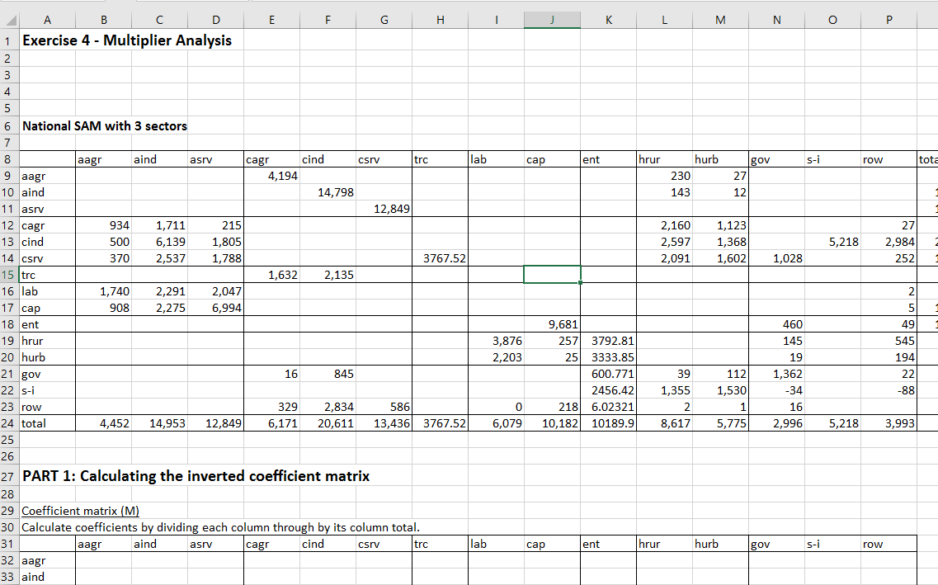
Exercise 4 | Multiplier Analysis
Estimate multiplier effects from an exogenous increase in demand
Will need multiplier functions MINVERSE and MMULT (CTRL+SHIFT+ENTER)
Exercises folder
Exercise 4 – Multiplier Analysis.xlsx

Slide 39
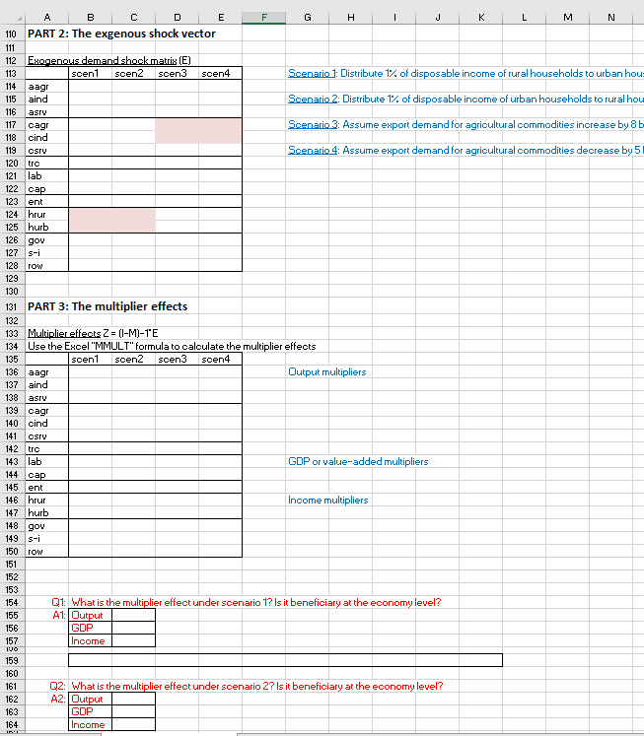
Exercise 4x | Multiplier Scenarios
Same SAM and multiplier model from Exercise 4
Run four simulations
1 & 2: Redistribute rural and urban incomes
3 & 4: Changes in agricultural export demand
Exercises folder
Exercise 4x – Multiplier Scenarios.xlsx

Slide 40
Part 4 Simple CGE Model

Slide 41
Tracing an Economic Shock
Using the SAM, we can trace economywide effects of production and demand changes
Example
Investment demand doubles
Sector production
Factor employment
Household income
Commodity demand

Slide 42
Closed-Economy, No Government
Factor costs
Wages & rents
Factor Markets
Domestic private savings
Firms
Households
Savings & Investment
Intermediate demand
Product Markets
Sales
Private consumption
Investment demand

Slide 43
Simple SAM
Incomes across rows
 |  | ACT |  | COM |  | FAC |  | HHD |  | INV | TOT
 |  | AG | NAG | AG | NAG | LAB | CAP | RUR | URB
ACT | AG |  |  | 60 |  |  |  |  |  |  | 60
 | NAG |  |  |  | 50 |  |  |  |  |  | 50
COM | AG |  |  |  |  |  |  | 40 | 20 |  | 60
 | NAG |  |  |  |  |  |  | 20 | 20 | 10 | 50
FAC | LAB | 40 | 20 |  |  |  |  |  |  |  | 60
 | CAP | 20 | 30 |  |  |  |  |  |  |  | 50
HHD | RUR |  |  |  |  | 40 | 20 |  |  |  | 60
 | URB |  |  |  |  | 20 | 30 |  |  |  | 50
SAV |  |  |  |  |  |  |  |  | 10 |  | 10
TOT |  | 60 | 50 | 60 | 50 | 60 | 50 | 60 | 50 | 10
0.66 | 0.40
0.33 | 0.40
 | 0.20
1.00 | 1.00
Expenditures down columns
0.66 | 0.40
0.33 | 0.60
1.00 | 1.00
0.66 | 0.40
0.33 | 0.60
1.00 | 1.00

Slide 44
Tracing an Economic Shock
Using the SAM, we can trace economywide effects of production and demand changes
Example
Investment demand doubles
Sector production
Factor employment
Household income
Commodity demand
Non-agricultural production rises
Non-agric. is capital-intensive - so capital incomes rise more than labor incomes
Most capital income goes to urban households
Urban households spend income on both agric. and non-agric. goods – so both sectors’ production must increase

Slide 45
Tracing Direct and Indirect Effects
Incomes across rows
 |  | ACT |  | COM |  | FAC |  | HHD |  | INV | TOT
 |  | AG | NAG | AG | NAG | LAB | CAP | RUR | URB
ACT | AG |  |  | 60 |  |  |  |  |  |  | 60
 | NAG |  |  |  | 50 |  |  |  |  |  | 50
COM | AG |  |  |  |  |  |  | 40 | 20 |  | 60
 | NAG |  |  |  |  |  |  | 20 | 20 | 10 | 50
FAC | LAB | 40 | 20 |  |  |  |  |  |  |  | 60
 | CAP | 20 | 30 |  |  |  |  |  |  |  | 50
HHD | RUR |  |  |  |  | 40 | 20 |  |  |  | 60
 | URB |  |  |  |  | 20 | 30 |  |  |  | 50
SAV |  |  |  |  |  |  |  |  | 10 |  | 10
TOT |  | 60 | 50 | 60 | 50 | 60 | 50 | 60 | 50 | 10
60
 | 60
0.66 | 0.40
0.33 | 0.40
 | 0.20
1.00 | 1.00
60
60
Expenditures down columns
42.6 | 22.25
21.8 | 22.25
20
60
60
0.66 | 0.40
0.33 | 0.60
1.00 | 1.00
40 | 24
20 | 36
64
56
0.66 | 0.40
0.33 | 0.60
1.00 | 1.00
42.4 | 22
21.6 | 34
64.4
55.6
 | 11.1
64.4 | 55.6
60 | 60
60 | 60
64 | 56

Slide 46
Why Do We Need a Model?
Even for a simple aggregate SAM, tracing the economywide impact of a shock quickly becomes complex
In our example, we stopped before second-round effects got started
We assumed no resource competition (i.e., production is unconstrained)
CGE models follow the logic of our example, but use equations to capture all structural linkages in the SAM
It is more precise and can use much larger and more complex SAMs
It captures resource constraints and market competition (i.e., role of prices in allocating labor/capital and agricultural/non-agricultural goods)

Slide 47



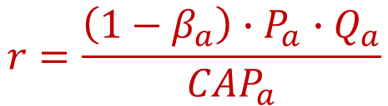
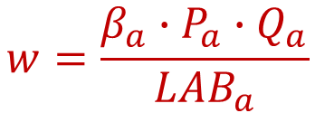
Simple CGE | Activity Production Functions
Production technologies are from SAM
 |  | ACT
 |  | AG | NAG
FAC | LAB | 40 | 20
 | CAP | 20 | 30
TOT |  | 60 | 50
$$Q_{a}=α∙{LAB}_{a}^{β_{a}}∙{CAP}_{a}^{1−β_{a}}$$
Resources are scarce and there is fixed supply
$$\overline{LABS}=\sum_{a}{{LAB}_{a}}$$
$$\overline{CAPS}=\sum_{a}{{CAP}_{a}}$$
So producers maximize profits while competing for scarce resources
(they pay wages and rents equal to the value of labor and capital’s marginal product)
$$w=\frac{β_{a}∙P_{a}∙Q_{a}}{{LAB}_{a}}$$
$$r=\frac{\left(1−β_{a}\right)∙P_{a}∙Q_{a}}{{CAP}_{a}}$$

Slide 48
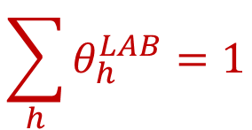
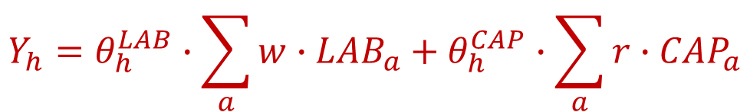
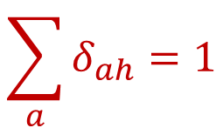

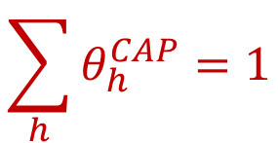
Simple CGE | Household Incomes and Spending
Factor incomes are paid to households based on fixed factor income shares (θ)
 |  | FAC |  | TOT
 |  | LAB | CAP
HHD | RUR | 40 | 20 | 60
 | URB | 20 | 30 | 50
TOT |  | 60 | 50
$$\sum_{h}{θ_{h}^{LAB}}=1$$
$$\sum_{h}{θ_{h}^{CAP}}=1$$
$$Y_{h}=θ_{h}^{LAB}∙\sum_{a}{w∙{LAB}_{a}}+θ_{h}^{CAP}∙\sum_{a}{r∙{CAP}_{a}}$$
Households save (S<1) and spend remainder on goods (fixed budget shares δ) to maximize utility
 |  | HHD
 |  | RUR | URB
COM | AG | 40 | 20
 | NAG | 20 | 20
SAV |  |  | 10
TOT |  | 60 | 50
$$P_{a}∙D_{ah}=δ_{ah}∙\left(1−S_{h}\right)∙Y_{h}$$
$$\sum_{a}{δ_{ah}}=1$$

Slide 49
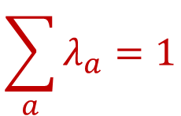
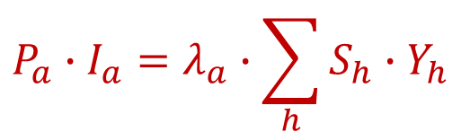


Simple CGE | Savings and Investment
 |  | INV
COM | AG
 | NAG | 10
TOT |  | 10
In equilibrium, investment demand equals total savings
$$P_{a}∙I_{a}=λ_{a}∙\sum_{h}{S_{h}∙Y_{h}}$$
$$\sum_{a}{λ_{a}}=1$$
BUT savings rates (S) and investment (I) cannot both be flexible
We must fix one of these variables… or
This is a macroeconomic closure rule, which tells the model how to balance the savings-investment account (i.e., should savings drive investment, or should investment drive savings?)
$$\overline{S_{h}}$$
$$\overline{I_{a}}$$

Slide 50



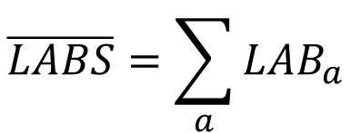
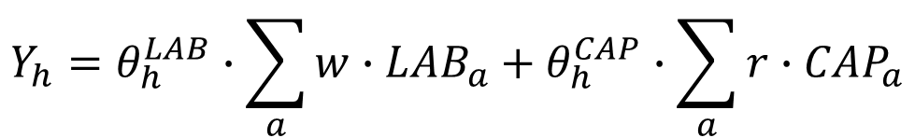




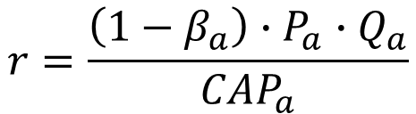

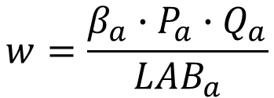


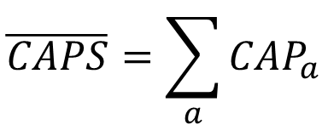
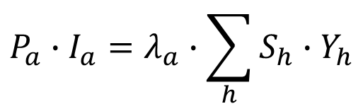

Simple CGE | Equations & Variables in the Model
$$Q_{a}=α∙{LAB}_{a}^{β_{a}}∙{CAP}_{a}^{1−β_{a}}$$
2eqs = 2vars
$$Q_{a}$$
$$w=\frac{β_{a}∙P_{a}∙Q_{a}}{{LAB}_{a}}$$
$$r=\frac{\left(1−β_{a}\right)∙P_{a}∙Q_{a}}{{CAP}_{a}}$$
$${LAB}_{a}$$
4eqs = 4vars
$${CAP}_{a}$$
$$\overline{LABS}=\sum_{a}{{LAB}_{a}}$$
$$\overline{CAPS}=\sum_{a}{{CAP}_{a}}$$
$$w$$
2eqs = 2vars
$$r$$
$$Y_{h}=θ_{h}^{LAB}∙\sum_{a}{w∙{LAB}_{a}}+θ_{h}^{CAP}∙\sum_{a}{r∙{CAP}_{a}}$$
2eqs = 2vars
$$Y_{h}$$
$$P_{a}∙I_{a}=λ_{a}∙\sum_{h}{S_{h}∙Y_{h}}$$
$$S_{h}$$
2eqs = 2vars
or
$$I_{a}$$
$$P_{a}∙D_{ah}=δ_{ah}∙\left(1−S_{h}\right)∙Y_{h}$$
4eqs = 4vars
$$D_{ah}$$

Slide 51
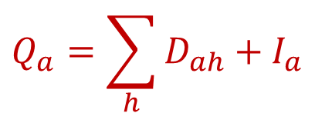
One More Equation
We have equations ensuring that total factor demand equals supply
Total commodity supply (Q_{a}) must equal the sum of household and investment demands
$$Q_{a}=\sum_{h}{D_{ah}}+I_{a}$$
There are two of these equations and two price variables (P_{a}) so we are now ‘square’ (i.e., no. equations = no. endogenous variables)
We need a ‘numeraire’ = a fixed price against which all other prices are compared to (i.e., acts as a value ‘anchor’ for the model)
If we fix a variable, we must drop an equation to stay ‘square’

Slide 52
Model Calibration and Simulation
Attach SAM values to the model’s parameters and variables
SAM is balanced, so model is initially balanced (i.e., in equilibrium)
When we shock the model, it falls out of equilibrium
Solve the model to find a new equilibrium
Difference in the values of the variables between the old and the new equilibriums is the impact of the shock (i.e., comparative statics)
We use the General Algebraic Modeling System (GAMS)
GEMPACK is another specialized modeling language/environment

Slide 53
Extensions in IFPRI Standard CGE Model
We use more complicated (flexible) functional forms:
Constant Elasticity of Substitution (CES) production functions so technologies change with relative factor prices
Linear Expenditure System (LES) of demand systems to allow for non-unity income elasticities
Include government and the rest of the world
CES and CET trade functions allow producers and consumers to shift between domestic and foreign markets
We also have two extra macro-closures
Government: Flexible tax rates or spending?
Current account: Flexible exchange rate or deficit?

Slide 54
Part 5 IFPRI Standard CGE Model

Slide 55

Why Have a Standard Model?
Common core model
Avoid reinventing the wheel
Quick to get up and running for new countries/SAMs
Can focus on new analysis rather than lots of programming
Versatile
Captures most unique country characteristics (e.g., taxes)
Can add complexity or special country characteristics
Easier to debug or to explain to others what you’re doing

Slide 56
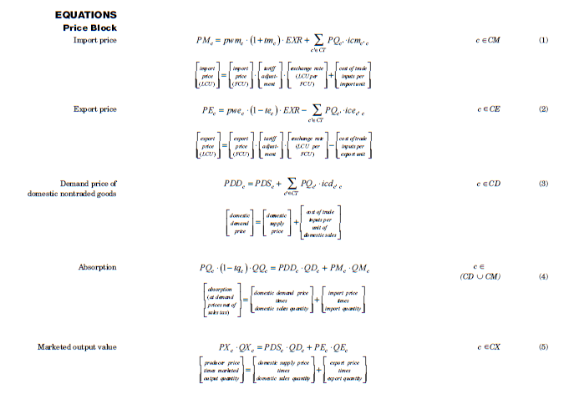
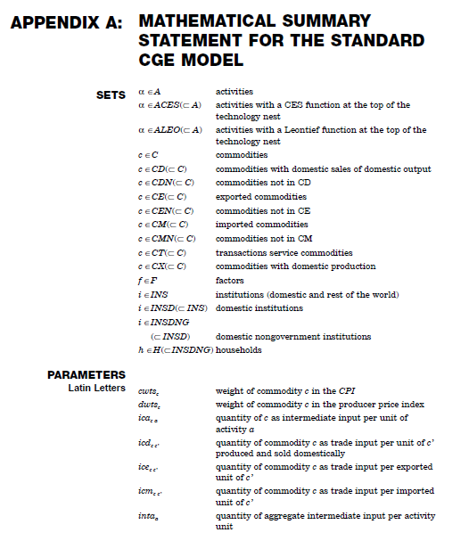
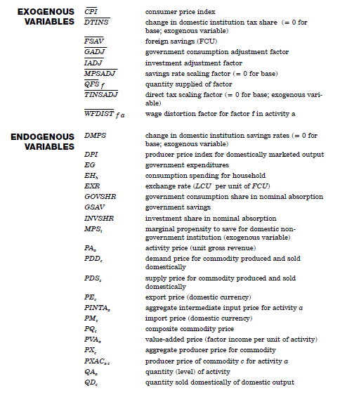
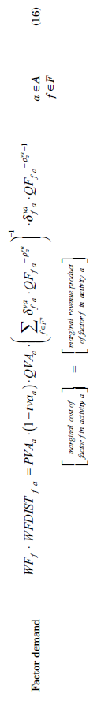
Too Many Equations, Variables and Parameters!
51 variables & 46 parameters
48 equations
Better to start with a conceptual understanding of the model

Slide 57
Flows in the Standard Model
Factor costs
Wages & rents
Factor Markets
Domestic private savings
Direct taxes
Public savings
Firms
Households
Government
Savings & Investment
Intermediate demand
Social transfers
Indirect taxes
Product Markets
Sales
Private consumption
Public consumption
Investment demand
Imports
Exports
Foreign Markets
Foreign savings or capital inflows

Slide 58



Functional Forms
Cobb-Douglas (CD)
Constant expenditure shares
$$Q=α∙L^{β}∙K^{1−β}$$
$$w∙L=β∙P∙Q$$
$$r∙K=\left(1−β\right)∙P∙Q$$
Constant Elasticity of Substitution (CES)
Shares relative to prices
Leontief
Fixed quantity ratios
Labor employment (L)
Labor employment (L)
r*/w
r/w
Capital employment (K)
Capital employment (K)

Slide 59
Linkages vs. Trade-Offs
Basic SAM layout
 | A | C | F | H | G | I | W | TOT
A
C
F
H
G
I
W
TOT
Linkages in the SAM
Backward & forward production linkages
Income/demand linkages
Foreign trade
Multiplier models assume unlimited resources
Implies that prices are fixed
No trade-offs
Resource constraints introduce trade-offs
Factors are limited = wage rates are set in markets
Product supply is limited = product prices adjust
Foreign exchange is limited = exchange rate adjusts
A = Activities
C = Commodities
F = Factors
H = Households
G = Government
I = Investment
W = Rest of world

Slide 60
Supply Chains | Activity Output
Basic SAM layout
WAREHOUSE
 | A | C | F | D | W | TOT
A
C
F
D
W
TOT
Activities vs. commodities
Some activities produce more than one commodity
Main commodity: Beef
By-product: Leather
Aggregate activity output
Final output is a combination (composite) of factor and intermediate inputs
No substitution
FACTORY
A = Activities
C = Commodities
F = Factors
D = Final demanders
W = Rest of world
Activity gross output
Production function
Producers can substitute between factors when relative factor prices change
Intermediate demand
Producers require inputs in fixed proportions and cannot substitute even if prices change
No substitution
Value-added
Intermediates
Substitution
No substitution
Labor
Land
Capital
Feed
Medicine
Other

Slide 61
Supply Chains | Commodity Supply & Demand
Product market closure
Demand & supply balance maintained via price changes
SUPERMARKET
Basic SAM layout
 | A | C | F | D | W | TOT
A
C
F
D
W
TOT
Households
Government
Investment
Intermediates
No substitution
No substitution
No substitution
No substitution
Total demand
Total supply
Composite commodity
A = Activities
C = Commodities
F = Factors
D = Final demanders
W = Rest of world
Import demand function
Substitution
Export supply function
Imports
Domestic sales
Exports
Output aggregation function
Combines commodities from different activities & allows substitution to ensure lowest composite price
WAREHOUSE
Substitution
Aggregate commodity output
Substitution
Main activity: Leather
Second activity: Livestock

Slide 62
Supply Chains | Summary
 | A | C | F | D | W | TOT
A
C
F
D
W
TOT
A = Activities
C = Commodities
F = Factors
D = Final demand
W = Rest of world
Equilibrium: Total commodity supply must equal total demand
(mediated by prices changes)
Factory
Activities combine factor and intermediate inputs to produce activity output
Warehouse
Warehouse sorts outputs from activities into bundles of like commodities
Trade
Commodity output is traded in export or domestic markets – latter is combined with imports
Supermarket
Composite supply is either sold to final demanders or to producers as inputs
Labor
Land
Value-added
Imports
×
×
=
Households
Capital
Activity output
Commodity output
Domestic sales
Composite supply
Government
=
=
Input 1
×
=
Investment
Input 2
Intermediates
Main output
Exports
=
=
Intermediate
Input N
By-product
×
× Price-driven substitution
= No substitution
Others’ output

Slide 63
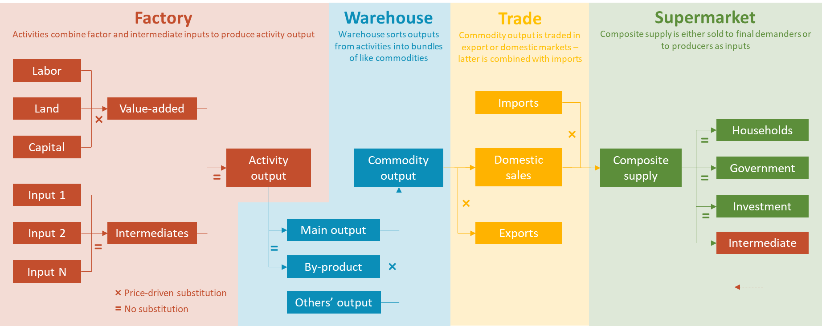
Supply Chains | Summary
 | A | C | F | D | W | TOT
A
C
F
D
W
TOT
A = Activities
C = Commodities
F = Factors
D = Final demand
W = Rest of world
Equilibrium: Total commodity supply must equal total demand
(mediated by prices changes)
QF QFS WF WFDIST
PVA QVA
PM QM
PA QA
PX QX
PQ QQ
QH
PDS PDD QD
QG
PINTA QINTA
PE QE
QINV
QINT
PXAC QXAC

Slide 64
Factor Markets | Closure Rules
 | A | C | F | D | W | TOT
A
C
F
D
W
TOT
A = Activities
C = Commodities
F = Factors
D = Final demand
W = Rest of world
Equilibrium: Total factor supply must equal sum of sectoral factor demand (determined by “closure rules”)
Factory
Workforce
=
Labor
+
Labor
+
Labor
Fix one
Economywide wage
Total factor supply
Land availability
=
Land
+
Land
+
Land
Value-added
×
Capital supply
=
Capital
+
Capital
+
Capital
× Price-driven substitution
Factor market closure
Adjust total factor supply?
Adjust wages?
Wages
Wages
Option 1
Full employment
Option 2
Unemployment
Employment
Employment

Slide 65
Institutions | Incomes & Spending
Basic SAM layout
Households
Government
Investment
World
 | A | C | F | H | G | I | W | TOT
A
C
F
H
G
I
W
TOT
Factor earnings
Direct taxes
Private savings
Exports
+
+
+
+
Total income
Transfers
Indirect taxes
Public savings
Grants + Remit.
+
+
+
+
Remittances
Grants
Foreign savings
Foreign savings
A = Activities
C = Commodities
F = Factors
H = Households
G = Government
I = Investment
W = Rest of world
=
=
=
=
Consumption
Consumption
Investment
Imports
+
+
Total spending
Direct taxes
Transfers
+
+
Savings
Savings

Slide 66
Macroeconomy | Closure Rules
 | A | C | F | H | G | I | W | TOT
A
C
F
H
G
I
W
TOT
A = Activities
C = Commodities
F = Factors
H = Households
G = Government
I = Investment
W = Rest of world
Equilibrium: Total receipts must equal total expenditures
(determined by “closure rules”)
Government
Recurrent fiscal deficit (savings) equals total revenues (taxes and grants) less total expenditures (consumption and transfers)
Fix two
Tax rates
Consumption
Public savings
Direct taxes
+
Indirect taxes
+
Grants
=
Consumption
+
Transfers
+
Public saving
Current account
Total inflow of foreign exchange (exports, grants and remittances) must equal total outflows (imports)
Fix one
Exchange rate
Foreign savings
Exports
+
Grants
+
Remittances
+
Foreign saving
=
Imports
Savings – Investment
Total supply of loanable funds (savings) must equal total investment demand
Fix one
Private savings rates
Investment
Private saving
+
Public saving
+
Foreign saving
=
Investment

Slide 67
Standard CGE Model | Key Features
Capture all economic linkages (based on the SAMs)
Drop the assumption that resources are unconstrained (i.e., fixed prices, as in multiplier models)
Product prices
Factor prices (labor wages, land rents, capital profits)
Exchange rate
Maintain macroeconomic & resource balances (no “free lunch”)
Government fiscal accounts
Investment & savings
Current account / balance of payments
Factor markets
Provides a consistent framework for tracking economywide impacts
Macro-accounting principles are respected (e.g., receipts must equal payments)
Macro and micro feedbacks are tracked (e.g., sectors, workers, households)

Slide 68
Standard CGE Model | Other Features
Enterprises
Receive some factor incomes (usually capital)
Pay taxes (corporate), save, remit
Pay whatever is left to households (i.e., indirect capital payments)
Taxes
Indirect: Producer taxes, sales taxes, factor taxes, and export taxes
Direct: Personal income taxes, corporate taxes
Tax changes can be proportional or point changes
Change in stocks or inventories
Residual investment (drawing down or increasing inventories)
No behavior or effect on savings-investment closure

Slide 69
Standard CGE Model | Calibration
Attach values to the model’s variables and parameters
Most data comes directly from the SAM
Usually assume that prices are equal to one – so quantities are equal to SAM values
But some data must come from external sources
Employment numbers (QF and QFS) – non-unitary wages (WF and WFDIST)
Household income elasticities for each commodity (budget surveys?)
Factor and trade substitution elasticities (GTAP?)

Slide 70
Part 6 Microsoft-Excel® Interface

Slide 71
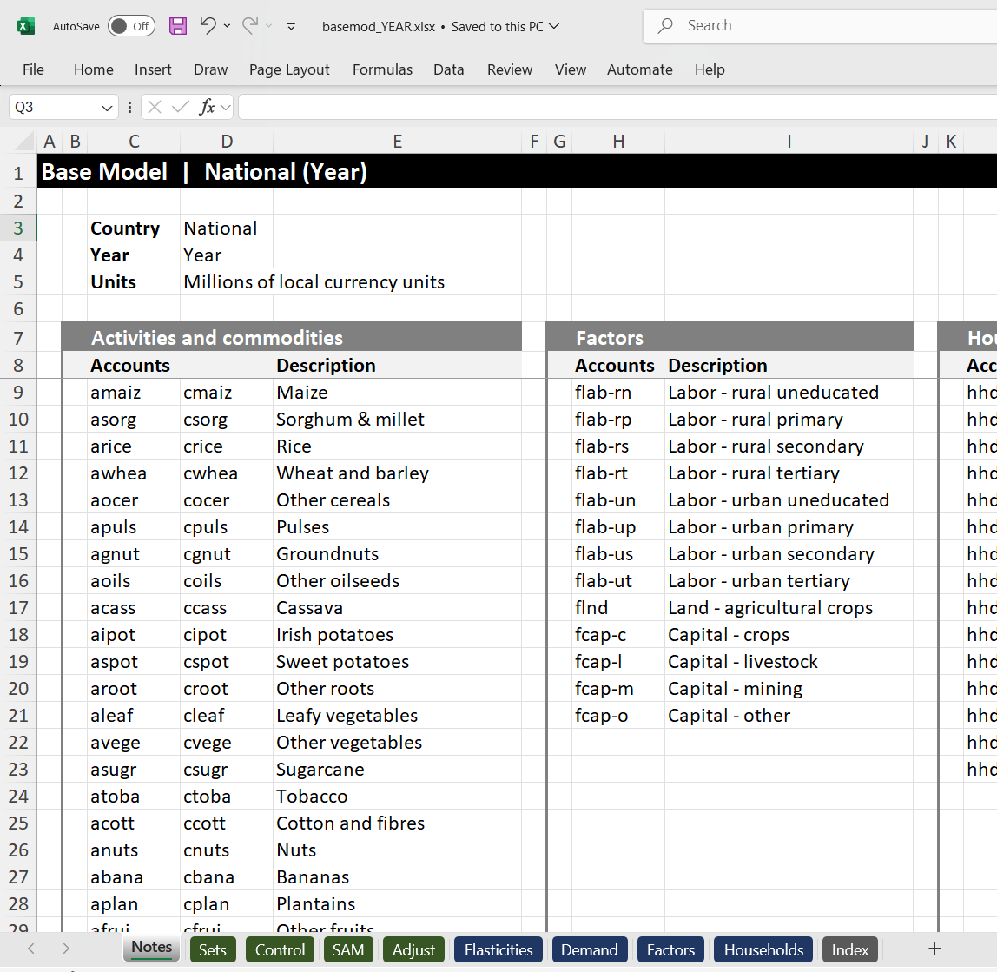
Standard Model
basemod.xlsx | Notes
IFPRI’s standard static model
Nexus SAM
90 activities & 90 commodities
13 factors of production
15 household groups
National data file sheets
SAM social accounting matrix
Control data scaling, exchange rate
Demand income elasticities
Elasticities trade/production elasticities
Factors wages, employment
Households population

Slide 72
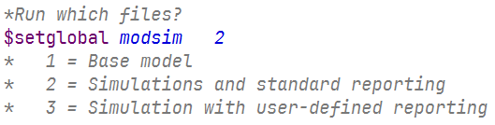
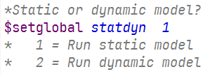
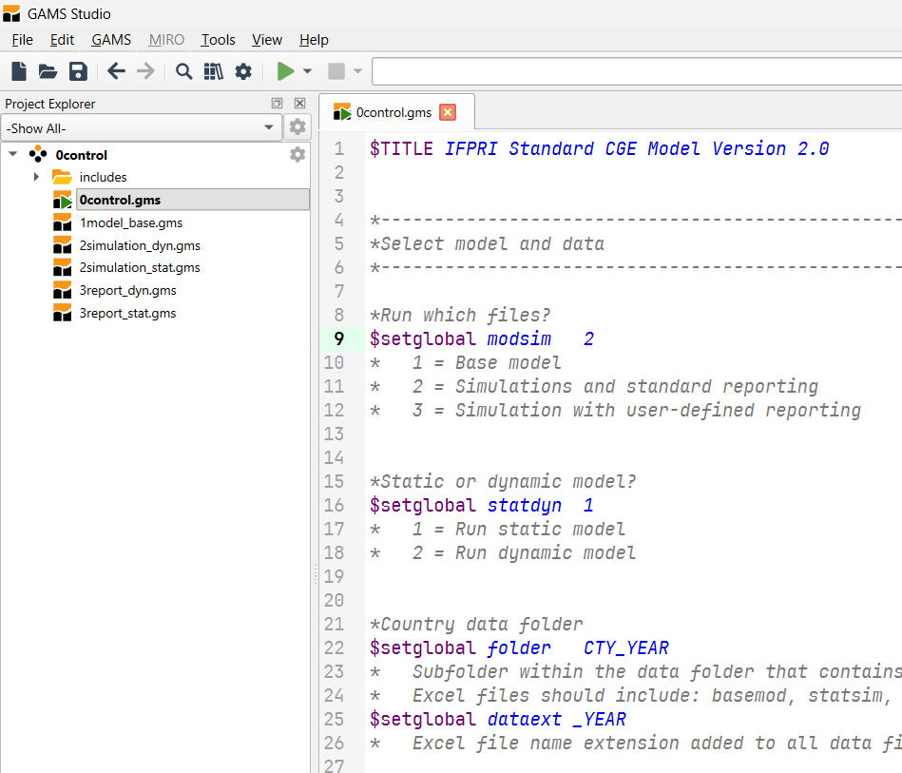
Running the Model _{(using GAMS Studio)}
Model Control
0control.gms
1
Model Data
basemod.xlsx
Model Code
1model.gms
2
2
Simulation Data
statsim.xlsx
Simulation Code
2simulation_static.gms
3
Results File
statrep.xlsx

Slide 73
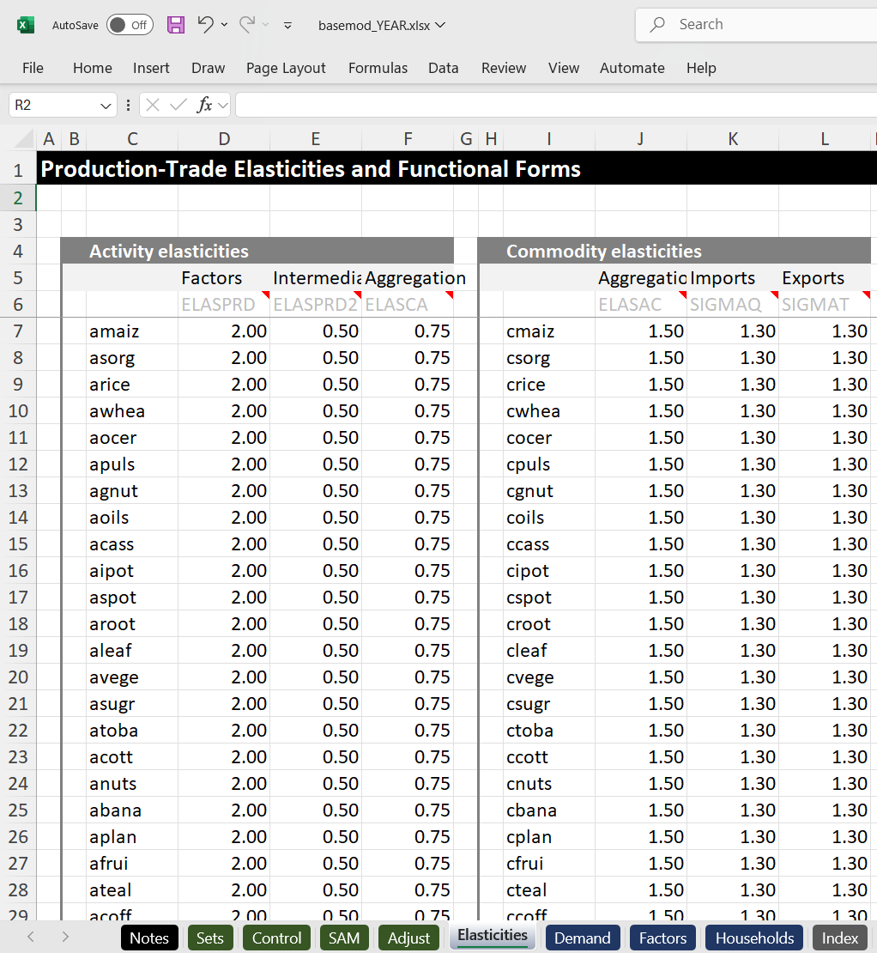
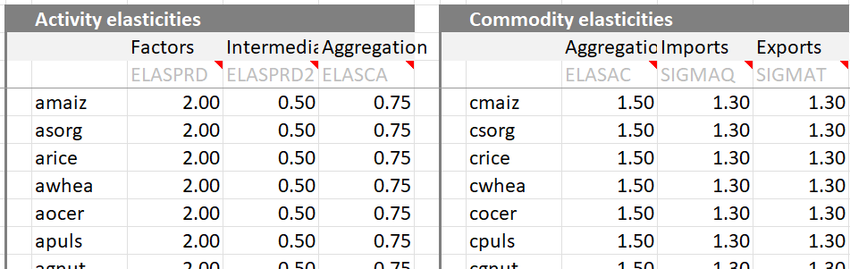
File 1 | Changing Model Data (Optional)
basemod.xlsx
Save file
Elasticities
basemod.xlsx | Elasticities

Slide 74
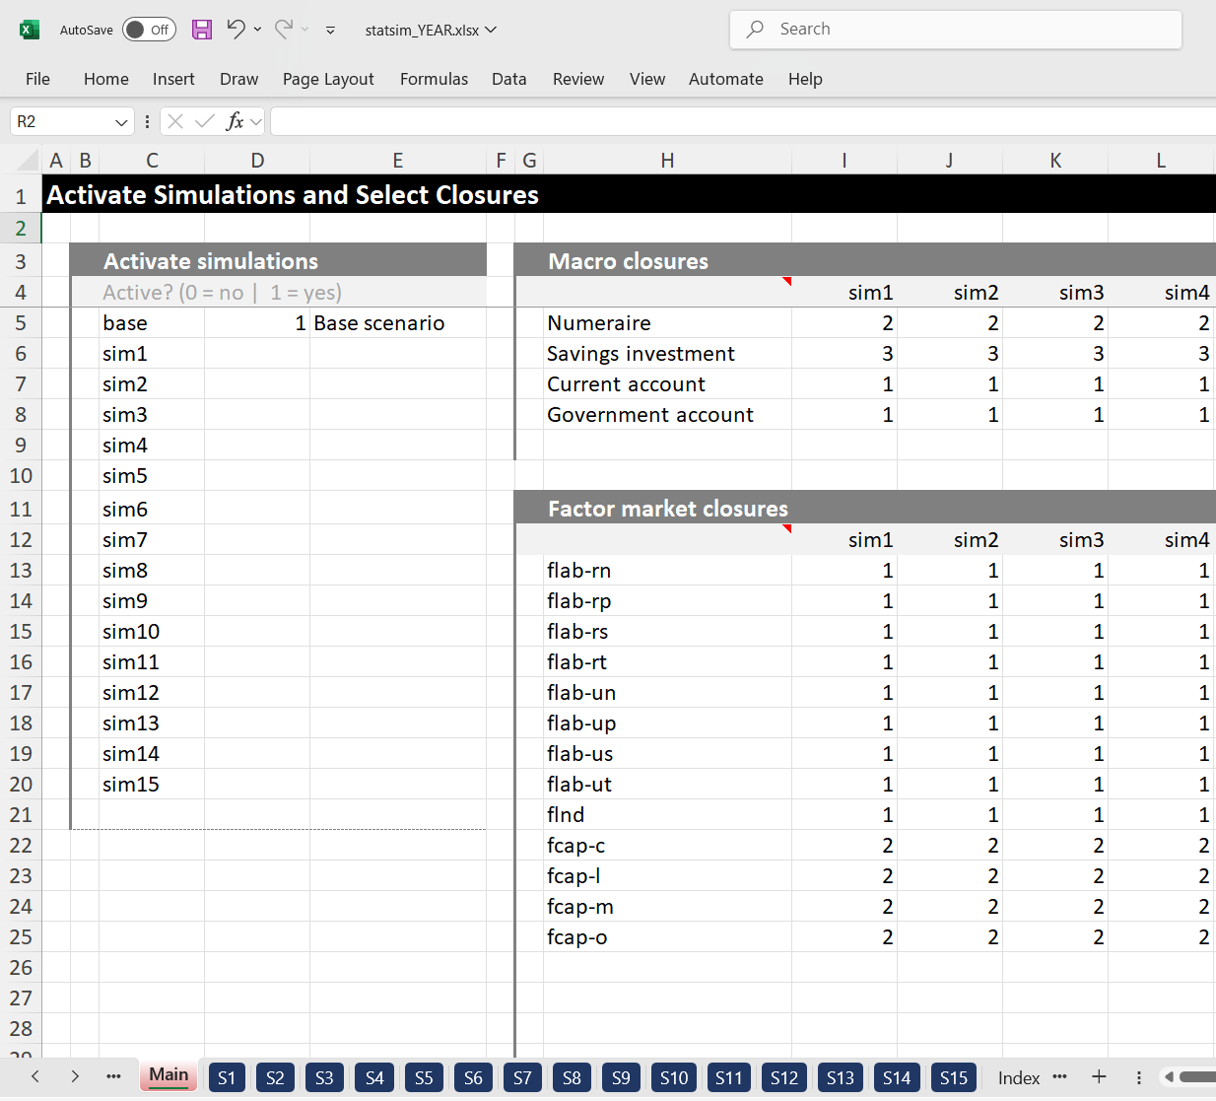
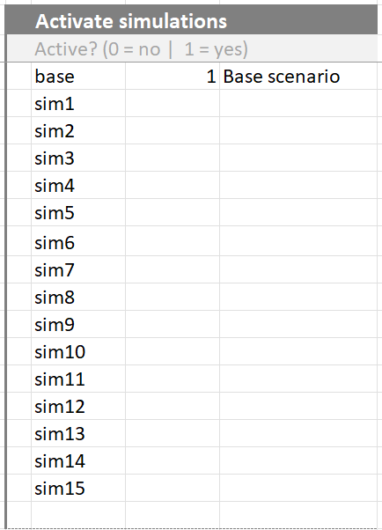
File 2.1 | Designing Simulations
statsim.xlsx
Naming and Activating Simulations
Name
Activate
Description
Main
statsim.xlsx | Main

Slide 75
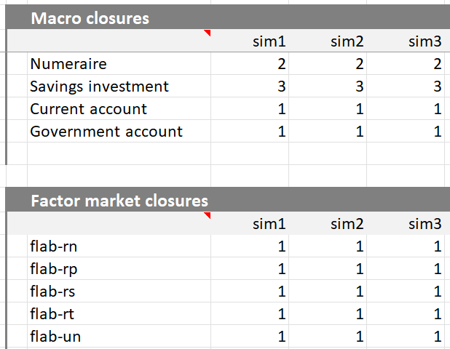
File 2.2 | Designing Simulations
statsim.xlsx
Selecting Macro and Factor Closures
Macro closures
Factor closures
Main
statsim.xlsx | Main

Slide 76
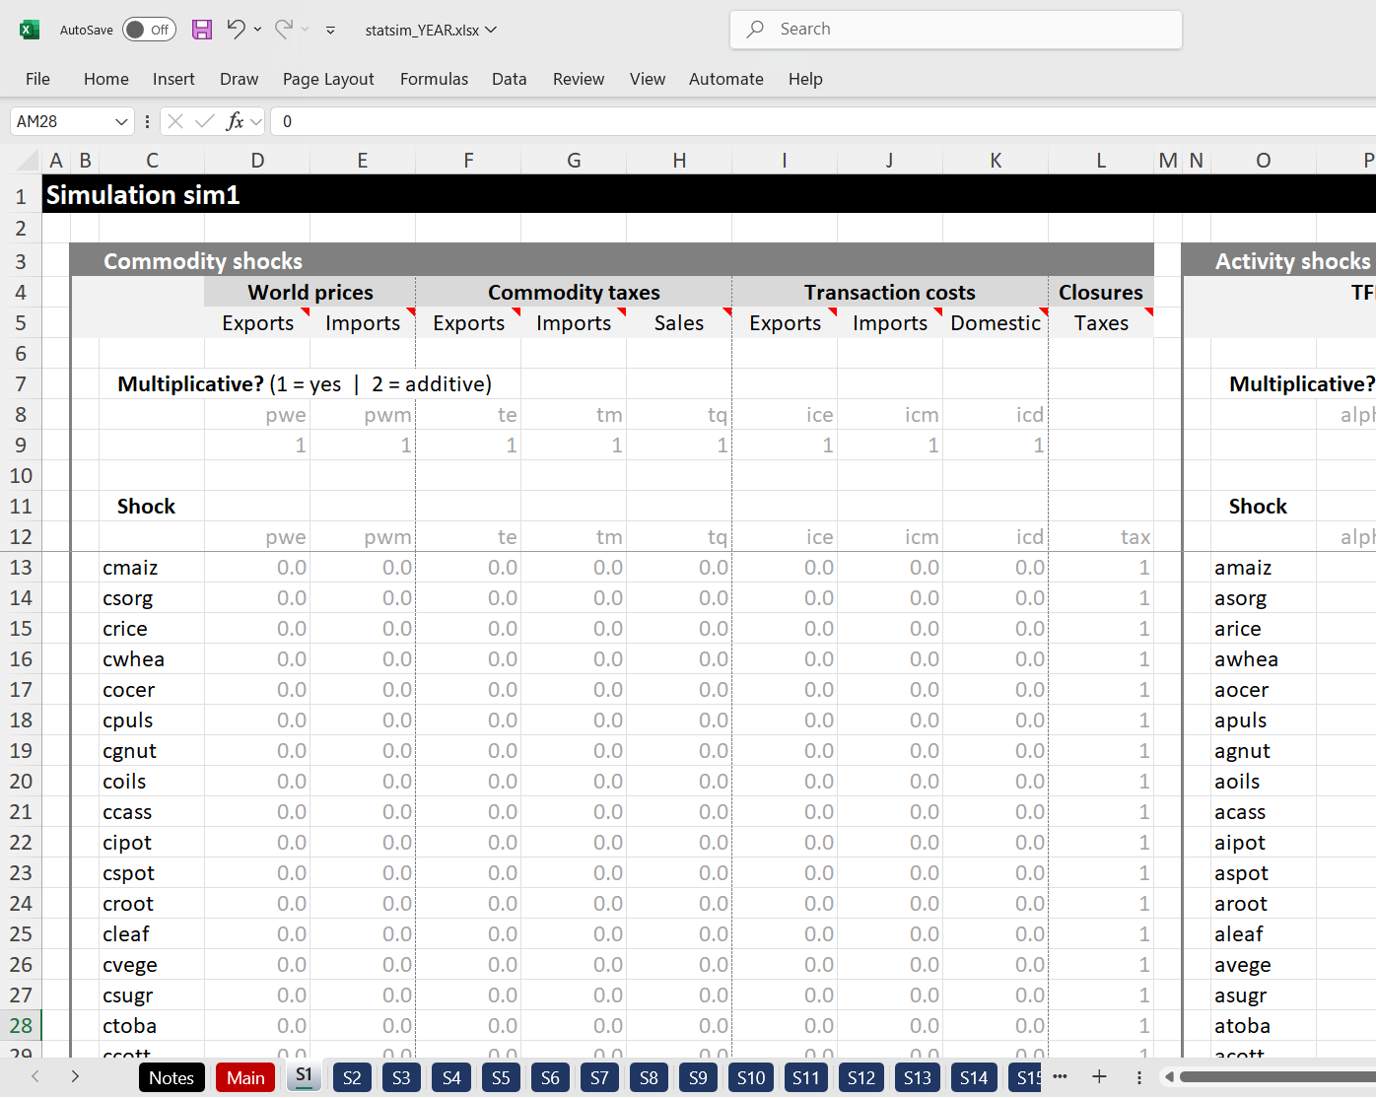
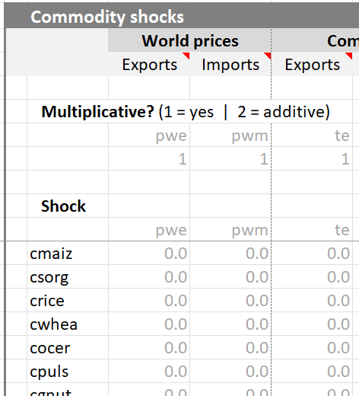
File 2.3 | Designing Simulations
statsim.xlsx
Imposing Shocks
statsim.xlsx | S1
Commodity
Type of shock
Change from initial parameter value
S1 sheet

Slide 77
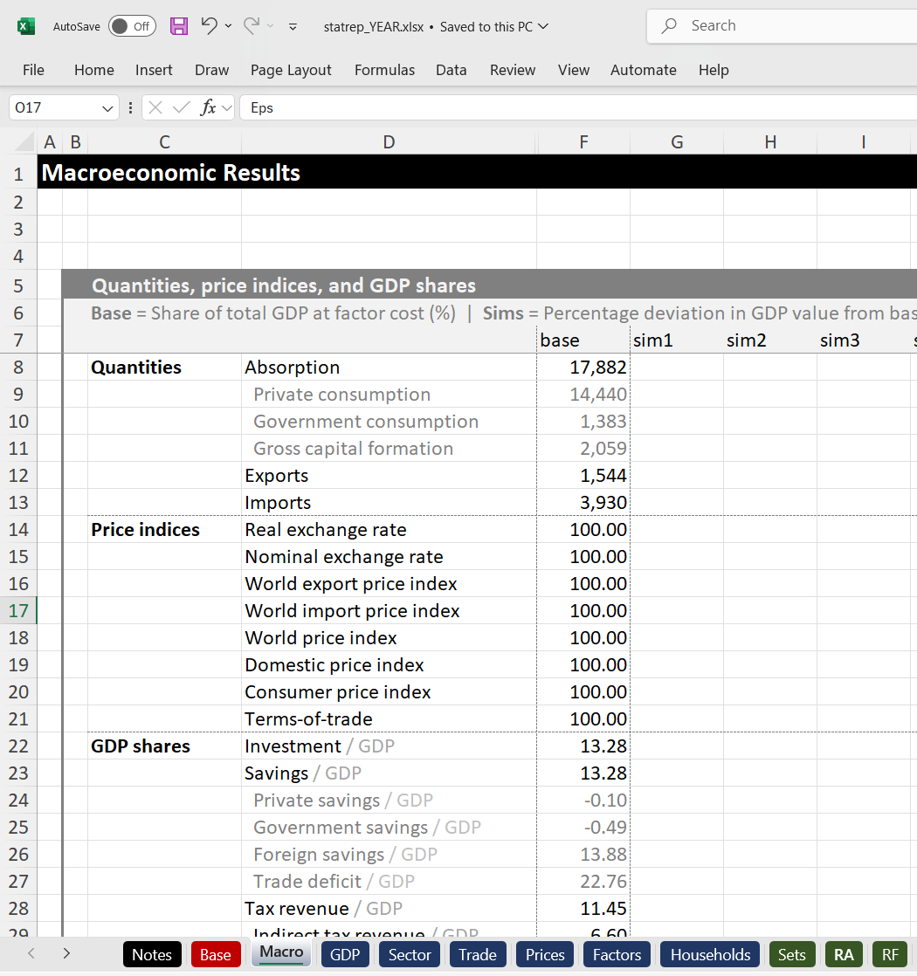
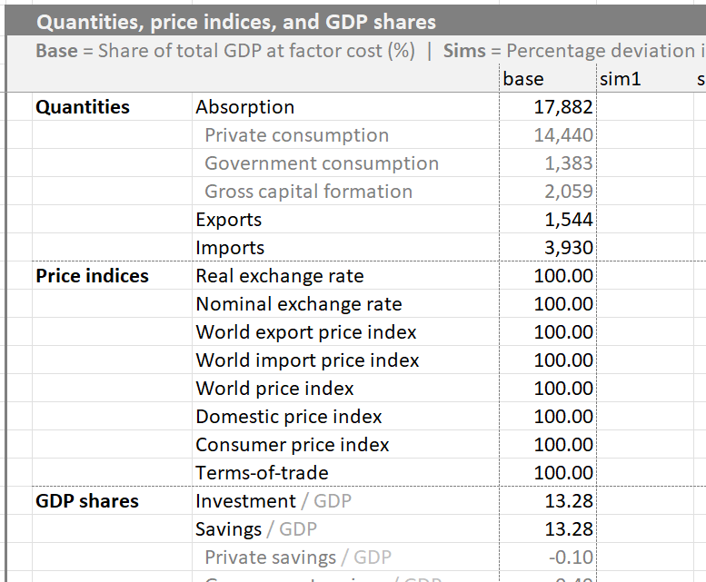
File 3 | Reviewing Results
statrep.xlsx
statrep.xlsx | Macro
Automatically saves and closes before reporting results

Slide 78
File 3 | Reviewing Results
Worksheet | Tables
Base | Initial sectoral production, trade and tax structure
Macro | Macroeconomic results, including exchange rates and CPI
GDP | GDP by expenditure group (nominal and real)
Sector | Sectoral GDP at factor cost
Trade | Real value of imports and exports
Prices | Producer, market and world prices
Factors | Total factor supply, economy-wide returns, total factor incomes, and sectoral factor demand
Households | Institutional incomes, equivalent variation (welfare), real expenditure by commodity, and institutional tax rates and collections

Slide 79
Note | Some Constraints to Using Interface
To run the interface version of the standard model you need licensed versions of Excel and GAMS (Path)
You cannot change SAM structure (for this you would need to adapt the interface)
BUT you can update the model to a more recent year using the SAM Toolkit
You cannot add new parameters to the interface
BUT all existing parameters in the standard model can be shocked using the interface

Slide 80
Note | Available Shock Parameters
Category | Parameter | Description
Commodity shocks | pwm pwe | World import and export prices
 | te tm | Export and import taxes
 | tq | Sales taxes
 | ice icm icd | Export, import and domestic transaction costs
 | tax | Closure: allow commodity taxes to change
Activity shocks | alphava | TFP (production function shift parameter)
 | ta tv | Activity and value-added taxes
 | fixcap | Closure: make capital sector-specific and fixed
 | fixlnd | Closure: make land sector-specific and fixed
 | alphaf | Closure: allow factor-specific productivity to change
 | tax | Closure: allow activity taxes to change
Factor shocks | wf | Economywide (average) factor returns
 | qfs | Total factor supply

Slide 81
Note | Available Shock Parameters
Category | Parameter | Description
Factor shocks | alphaf | Factor-specific productivity
(continued) | tf | Factor taxes
 | trtg | Factor transfers to government
 | trtw | Factor transfers to rest of world
 | trfg | Factor transfers from government
 | trfw | Factor transfers from rest of world
Household and | pop | Household population
enterprise shocks | mps | Marginal propensity to save
 | ti | Direct institution taxes
 | trtg | Domestic institution transfers to government
 | trtw | Domestic institution transfers to rest of world
 | trfg | Domestic institution transfers from government
 | trfw | Domestic institution transfers from rest of world

Slide 82
Note | Available Shock Parameters
Category | Parameter | Description
Macroeconomic shocks | exr | Exchange rate
 | fsav | Foreign savings
 | iadj | Investment demand
 | invshr | Investment share of total absorption
 | mps | Savings rates (all institutions together)
 | gsav | Government savings
 | gadj | Government spending
 | govshr | Government share of total absorption
 | te | Export taxes (all commodities)
 | tm | Import tariffs (all commodities)
 | tq | Sales taxes (all commodities)
 | ta | Activity taxes (all activities)
 | tv | Value-added taxes (all activities)
 | tf | Factor taxes (all factors)
 | ti | Direct taxes (all domestic institutions)

Slide 83
Part 6 (continued) Exercises Using the Interface Model

Slide 84
Exercise 5 | Foreign Capital Outflows
Shock
Reduce foreign capital inflows by 50% (i.e., -50% foreign savings)
Four sets of closures
Sim1: Full employment, savings-driven investment (fixed savings rates, flexible investment)
Sim2: Full employment, investment-driven savings (fixed investment, flexible savings rates, scaled MPS adjustment)
Sim3: Unemployment, investment-driven savings (fixed wage rate, flexible labor supply , scaled MPS adjustment)
Sim4: Unemployment, investment-driven savings (fixed wage rate, flexible labor supply , uniform MPS adjustment)
Current account
Total inflow of foreign exchange (exports, grants and remittances) must equal total outflows (imports)
Fix one
Exchange rate
Foreign savings
Exports
+
Grants
+
Remittances
+
Foreign saving
=
Imports
Savings – Investment
Total supply of loanable funds (savings) must equal total investment demand
Fix one
Savings rates
Investment
Private saving
+
Public saving
+
Foreign saving
=
Investment

Slide 85
Exercise 5 | Walkthrough
Macro
↓Foreign savings = Exchange shortage → Real exchange rate depreciation → ↑Exports & ↓Imports
↓Foreign savings = ↓Loanable funds → ↓Investment OR ↑Private savings
↑Private savings → ↓Private consumption
Trade (+ Base)
Depreciation → ↑Export-oriented products (e.g., textiles) & ↓Import-intensive products (e.g., machinery)
Sector
↓Investment → ↓Construction
↓Private consumption → ↓Food (e.g., crops, livestock, etc.)
Factors
↓Wages OR ↑Employment (larger ↓wage with ↓construction, which is capital-intensive)
Households
↓Private consumption (larger with ↑private savings)
Higher income households are worst-affected (less so with uniform savings rate adjustments)

Slide 86
Exercise 6 | Tariff Liberalization
Shock
Eliminate all tariffs (i.e., -100%)
Two sets of closures
Sim1: Full employment, savings-driven investment, deficit financed (fixed savings rates, flexible investment, flexible government savings)
Sim2: Full employment, savings-driven investment, tax financed (fixed savings rates, flexible investment, flexible scaled direct tax rates)
Government
Recurrent fiscal deficit (savings) equals total revenues (taxes and grants) less total expenditures (consumption and transfers)
Fix two
Tax rates
Consumption
Public savings
Direct taxes
+
Indirect taxes
+
Grants
=
Consumption
+
Transfers
+
Public saving
Savings – Investment
Total supply of loanable funds (savings) must equal total investment demand
Fix one
Savings rates
Investment
Private saving
+
Public saving
+
Foreign saving
=
Investment

Slide 87
Exercise 6 | Walkthrough
Macro
↓Tariffs → ↑Imports → Real exchange rate depreciation → ↑Exports
↓Tariffs → ↓Consumer prices → ↑Private consumption
↓Tariffs = Revenue shortfall → ↓Public savings OR ↑Tax rates
↓Public savings → ↓Investment
↑Tax rates → Smaller ↑private consumption
Trade (+ Base)
↓Tariffs → ↑Import-intensive commodities
Sector
↓Tariffs → ↓GDP for import-competing sectors
Households
↑Private consumption (smaller with ↑private savings)
↑Tax rates → ↓Consumption for high-income urban households

Slide 88
Group Exercises (1)
1. Flooding the fields
Reduce crop productivity (TFP) by 20%
2. Running on empty
Increase world oil (petroleum and fertilizer) prices by 30%
3. Lights out
Productivity (TFP) in the electricity sector falls by 20%
4. Buck stops here
Halve foreign remittance inflows
5. Emperor’s clothes
World prices for textiles and clothing drop 30%

Slide 89
Group Exercises (2)
6. Saving the planet
Impose a 50% tax (negative subsidy) on fossil fuel-related imports
7. Robin Hood
Double government transfers to poor households (find a way to pay for it)
8. Building bridges
Increase capital investment in trade and transport infrastructure
9. Filling the coffers
Increase government revenues using different instruments

Slide 90
Part 7 Extending the Standard Model

Slide 91
Three Extensions
Recursive dynamics
Simple dynamic specification
Microsimulation
Linking to the household survey
Additional accounts
Environmental accounts (e.g., natural resources, pollution, etc.)
Financial accounts (i.e., monetary sector variables)

Slide 92
Recursive Dynamics | Counterfactual Analysis
CGE model is a laboratory for experimenting with different policies and shocks[
Counterfactual analysis measures outcomes with (before) and without (after) shock or intervention
Can be used as either static or dynamic model
Choice depends on the policy or shock being analyzed (e.g., impacts of a rapid onset shock vs. designing long-term investment strategies)
In a static model:
With policy
Impact of policy
In a dynamic model:
Without policy
(baseline)
Base year
Final year

Slide 93
Recursive Dynamics | Annual Updates
CGE model is solved annually with inter-annual updates to key parameters
Endogenous updates depend on results from previous years
Exogenous updates are fixed over time
Endogenous Updating
Exogenous Updating
Capital accumulation rate
Depends on previous year’s investment levels, which are themselves endogenous (i.e., of national incomes and savings rates)
Capital allocation by sector
Depends on past investment allocations and previous year’s relative profits across sectors
Population & labor supply
Rural & urban projections from UNDESA or official data
Labor adjusted using labor force survey trends
Land supply & agric. productivity
Based on FAO or official trends (total cultivated area)
Macroeconomy
Baseline assumes trends from previous decade continues (incl. GDP growth by sector, absorption structure, trade balance, remittances/FDI, etc.)

Slide 94
Recursive Dynamics | Endogenous Capital Accumulation
Capital accumulation
Factor costs
Wages & rents
Factor Markets
Domestic private savings
TFP growth
Direct taxes
Public savings
Labor supply
Firms
Households
Government
Savings & Investment
Intermediate demand
Social transfers
Indirect taxes
Product Markets
Sales
Private consumption
Public consumption
Investment demand
Public Consumption
Investment demand
Imports
Foreign Markets
Foreign savings or capital inflows
Exports
Foreign savings or capital inflows

Slide 95
Microsimulation | Linking to Survey Households
Each household in the CGE model represents a group of individual households in the household survey (like survey weights)
[
Each CGE household is linked to its corresponding survey households
CGE household
RURAL
CGE household
Urban
Survey household 1
Survey household 5
Survey household 2
Survey household 6
Survey household 3
Survey household 7
Survey household 4
Survey household 8

Slide 96
Microsimulation | Tracking Household Level Outcomes
Pass down changes in key variables from CGE model to survey
Recalculate per capita expenditures for survey households
Some microsimulation models estimate who loses or gains a job
e.g., Occupational choice models
Some also pass information back up to the CGE model
CGE model
Employment levels
Factor incomes
Commodity prices
Consumption levels
Household survey

Slide 97
Additional Accounts
Natural resource accounts
Water use by industry and household (for water use rights or user fees)
Environmental accounts
Pollution levels for each industry (for pollution taxes or health feedbacks)
Carbon emissions for each industry and product (for carbon taxes or cap-and-trade schemes)
Financial accounts
New institutions (banking sector)
Assets and liabilities (investments, money holdings, bonds, loans, etc.)
Allows for CGE models with monetary variables (e.g., money supply, interest rates, inflation, etc.)

Slide 98
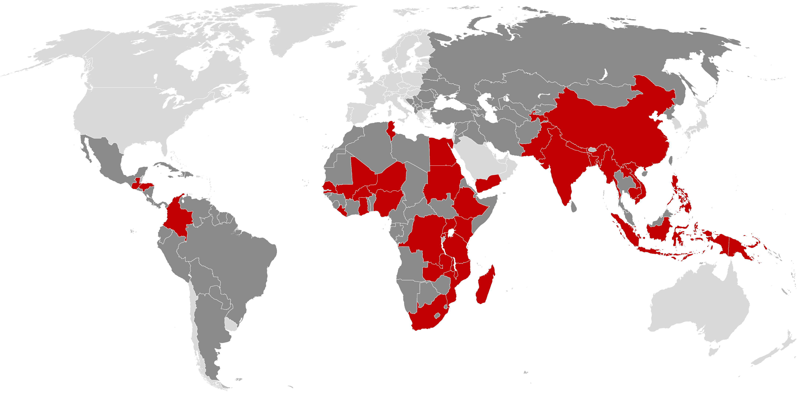












RIAPA | Data & Modeling System
38 countries with RIAPA models
(4 still under development)
Rural Investment and Policy Analysis (RIAPA)
Forward-looking economywide framework that captures entire national economies, unpacks agrifood systems and subnational regions, and tracks how policies, investments, and climate risks affect different sectors, workers and population groups
Investment tools track spending levels, unit costs, and intermediate outcomes
(e.g., productivity gains, profit margins)
Investment Tools
Linked Models
Value chains
(PPVC)
Other developing countries
RIAPA countries
Animal system
(LEAS)
SAMs reconcile data from national accounts, government finances, and firm/household surveys
Data
Cross-cutting policies (AIDA)
Crop growth
(DSSAT & SPAM)
Linked models track global and biophysical drivers (e.g., animal herds, crop yields, world prices)
Population
Model Outputs
Social Inclusion Outcomes
Economic Outcomes
Social accounting matrices (NEXUS)
Model Inputs
Global markets
(IMPACT, MIRAGE)
RIAPA
Dynamic economywide model
Agric. employment
Outcomes are tracked across the agri-food system (e.g., farming, processing, trade, transport, hotels, food services)
Survey-based microsimulation modules estimate outcomes at individual and household levels
Agri-food system growth (AgGDP+)
Poverty & inequality
Undernourishment
Agri-food system jobs (AgEMP+)
Hunger & diet quality (ReDD)
Poverty
Food system resilience
Women’s inclusion (WIST)
GHG emissions
Source: WB country classification (2019) & poverty (2014); ILO employment (2019); FAO undernourishment (2019); WRI emissions (2019)

Slide 99
Further Reading
Recursive dynamics
Diao and Thurlow. 2012. A Recursive Dynamic Computable General Equilibrium Model. In Diao et al. (eds.). Strategies and Priorities for African Agriculture: Economywide Perspectives from Country Studies. Washington DC, USA: IFPRI.
Microsimulation
Arndt et al. 2013. Explaining the Evolution of Poverty: The Case of Mozambique. American Journal of Agricultural Economics 95(1): 206-206.
Pauw and Thurlow. 2011. Agricultural Growth, Poverty, and Nutrition in Tanzania. Food Policy 36(6): 795-804.
Environment and natural resources
Alton et al. 2014. Introducing Carbon Taxes in South Africa. Applied Energy 116(1): 344-354.
Hassan and Thurlow. 2011. Macro-Micro Feedback Links of Water Management in South Africa: CGE Analyses of Selected Policy Regimes. Agricultural Economics 42(2) : 235-247.
[
Shocks and extreme events
Arndt et al. 2008. Higher fuel and food prices: impacts and responses for Mozambique. Agricultural Economics 39: 497-511.
Pauw et al. 2011. The Economic Costs of Extreme Weather Events: A Hydro-Meteorological CGE Analysis for Malawi. Environment and Development Economics 16(2) : 177-198.
Thurlow et al. 2011. The Impact of the Global Commodity and Financial Crises on Poverty in Vietnam. Journal of Globalization and Development 2(1): 1-29.

